Slide 1

Diagnosis of Inflammation in Urinary System
Analysis by
Katie Briggs
DSC 680 Applied Data Science

Slide 2
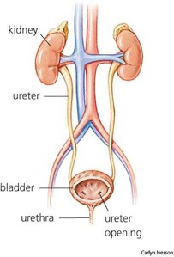
The Urinary System
Consists of :
Kidneys
Renal Pelvis
Ureters
Bladder
Urethra
Works to filter blood and create urine as a waste by Product.

Slide 3
Background
Most Frequent Symptoms of Urinary Discomfort:
Occurrence of Nausea
Lumbar pain
Frequent Urination
Micturition Pain (pain while urinating)
Urethra Symptoms
Nephritis and Inflammation of the Bladder have similar symptoms and diagnosis can be difficult.

Slide 4

Reason for Analysis
To perform a presumptive diagnosis of two urinary diseases: Nephritis or Inflammation of the Bladder based on the symptoms gathered from patients using a Decision Tree Model.

Slide 5
Exploration and Data Preparation
Merge Datasets, remove null values, and categoric to Boolean.
While merged the dataset yielded 120 rows and 8 columns.
Yes/No answer were changed to “1” and “0”.
Determine relationships between symptoms.
Lumbar Pain is almost always seen in Nephritis.
Frequent Urination is seen in both Nephritis and Inflammation.
Micturition Pain is seen more in Inflammation of the Bladder than in Nephritis.

Slide 6


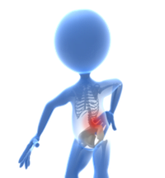

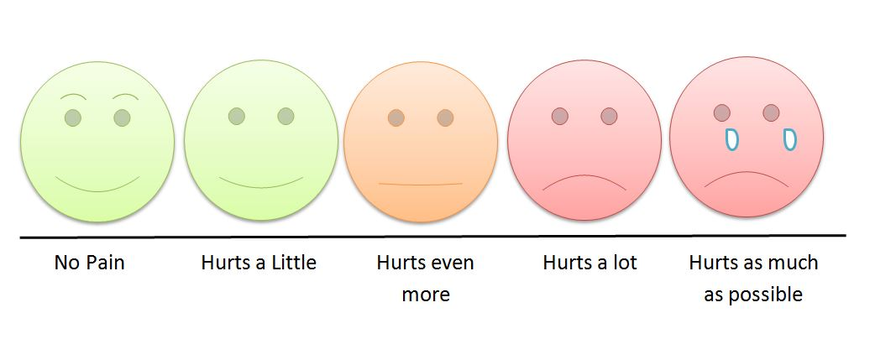
Feature Selection:
There were no outliers detected within the dataset.
Temperature was the only categorical variable in set.
T
Body Temperature
Nausea or Vomiting
Lumbar Pain
Urination and Urethra Symptoms
Inflammation

Slide 7
Decision Tree Model
Train, Test, Split on 75%/25% of Data.
Model based on Independent features and dependent responses.
Predict on Training and testing data of features.

Slide 8
Accuracy of Model
Confusion Matrix
100%
Decision | Yes | Yes
Inflammation | 16 | 0
Nephritis | 0 | 14

Slide 9
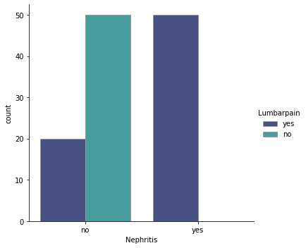
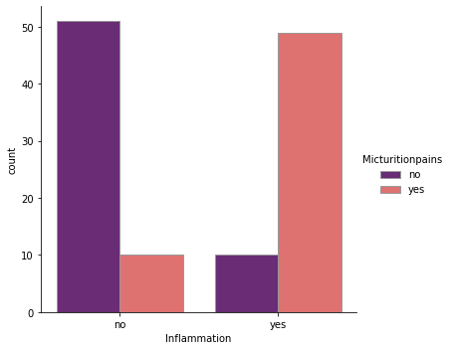
Results
Lumbar Pain is seen in 99% of patients with Nephritis.
Micturition Pain has been highly seen in patients with bladder inflammation but as compared to nephritis.

Slide 10
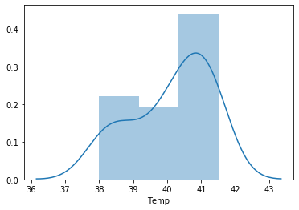
Results continued
Body Temperature in Nephritis
Higher body temperature is present in patients with Nephritis.
It is even higher with the patient has both Nephritis and Inflammation.

Slide 11

Conclusion
Lumbar pain symptoms are in more than half of the reported cases with a diagnosis of Nephritis.
Urination symptoms such as, blood in urine and frequent voiding are also high in patients with diagnosed Nephritis.
Nausea and Micturition Pain are found more in patients with Inflammation of Bladder.
A Decision Tree Model can aid in the diagnosis of urinary diseases.

Slide 12
Acknowledgements
UCI Machine Learning Repository
For Data Set
Bellevue University
Professor Williams

Slide 13
References:
[1] UCI Machine Learning Repository, Acute Inflammation data set, Classification, with multivariate data characteristics, Attributes are categorical and integer. https://archive.ics.uci.edu/ml/datasets/Acute+Inflammations
[2] Medial News Today, lists symptoms of acute nephritis, the different types of nephritis and causes. Symptoms will be used as a guide to diagnose in model. Murrell, D., (2018), What to know about nephritis, Retrieved from: https://www.medicalnewstoday.com/articles/312579
[3] Grover, S., Srivastava, A., Lee, R., Tewari, A. K., & Te, A. E. (2011). Role of inflammation in bladder function and interstitial cystitis. Therapeutic advances in urology, 3(1), 19–33. Symptoms of acute inflammation in the bladder to use for diagnosis model. Retrieved from: https://doi.org/10.1177/1756287211398255
[4] J.Czerniak, H.Zarzycki, Application of rough sets in the presumptive diagnosis of urinary system diseases, Artifical Inteligence and Security in Computing Systems, ACS'2002 9th International Conference Proceedings, Kluwer Academic Publishers, 2003, pp. 41-51
[5] Kaggle, data sets of attributes with symptom information. https://www.kaggle.com/subh86/acute-nephritis
[6] UTDallas, Medical Diagnosis with using decision trees, Understanding how doctor’s diagnose
medical conditions based on symptoms. Retrieved from:
https://www.utdallas.edu/~nrr150130/cs6375/2015fa/lects/Lecture_6_Decision.pdf
[7] Decision Tree Classification, An overview of using decision tree classifiers. Chakure, A. (2019),
Retrieved from: https://medium.com/swlh/decision-tree-classification-de64fc4d5aac
[8] Gradient Boosting for trees. Brownlee, J.,(2020), A Gentle Introduction to the Gradinet Boosting
Algorithm for Machine Learning, Retrieved from:
https://machinelearningmastery.com/gentle- introduction-gradient-boosting-algorithm-machinelearning/
[9] Diagnose urinary inflammations using Neural Designer, an example of machine learning diagnosis.
https://www.neuraldesigner.com/learning/examples/urinary-inflammation-diagnosis
[10] Predicting urinary tract infections in the emergency department with machine learning, Taylor, Moore, C., Brandt, C., (2018), https://doi.org/10.1371/journal.pone.0194085

Slide 14
Questions

